Slide 1
Object-Oriented Programming (CIS1056-N)
Inheritance Demo

Slide 2
Inheritance Recap
Classes can inherit from another class
Keyword: extends
Java only allow single inheritance
Defines an IS-A relationship:
Lamp IS-A ElectricalDevice
Cow IS-A Animal
In Java, the absence of explicit inheritance means that a class inherits from class Object
Several methods are implemented here, including toString()
@Override advises the compiler to check that the overridden method actually exists is the super-type
class A {
@Override
public String toString() {
return "Class: A"
}
}
class B extends A {
@Override
public String toString() {
return super.toString() +
" Class: B";
}
}

Slide 3
Animal class (the Super-type)
class Animal {
protected String name;
public Animal(String n) {
name = n;
}
public Animal() { //default constructor
name = "the beast";
}
public void talk() {
System.out.println(
String.format(
"%s the %s made a strange noise",
name,
this.getClass().getSimpleName()));
}
}

Slide 4
Cat Class (the Sub-type)
public class Cat extends Animal {
public Cat() {
super();
}
public Cat(String n) {
super(n);
}
@Override
public void talk() {
System.out.println(
String.format(
"%s the %s miaowed",
name,
this.getClass().getSimpleName()));
}
}
public class Cat extends Animal {
public Cat() {
super();
}
public Cat(String n) {
super(n);
}
@Override
public void talk() {
System.out.println(
String.format(
"%s the %s miaowed",
name,
this.getClass().getSimpleName()));
}
}
Inherited and overridden method
Inherited and overridden method

Slide 5
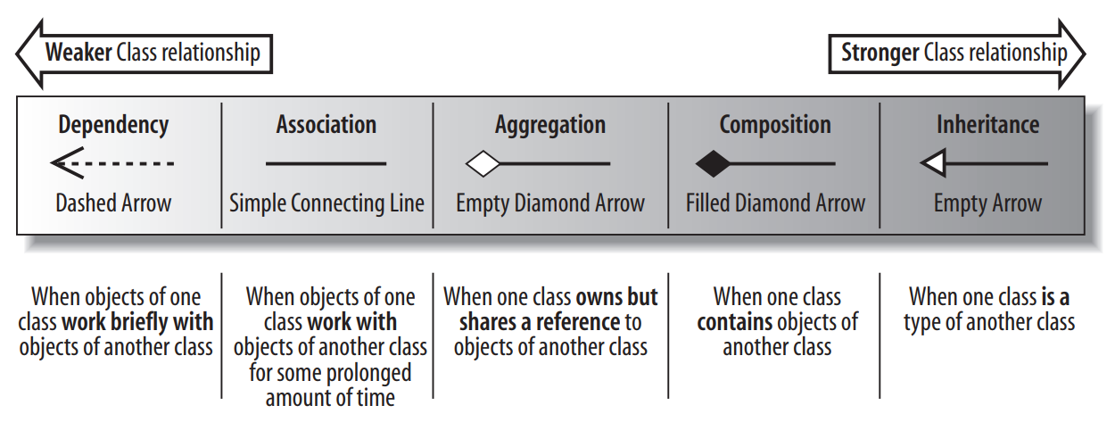
Inheritance association
The strongest relationship between two classes
An unbreakable relationship between two classes
You can’t split the Animal out of the Cow after the fact!

Slide 6
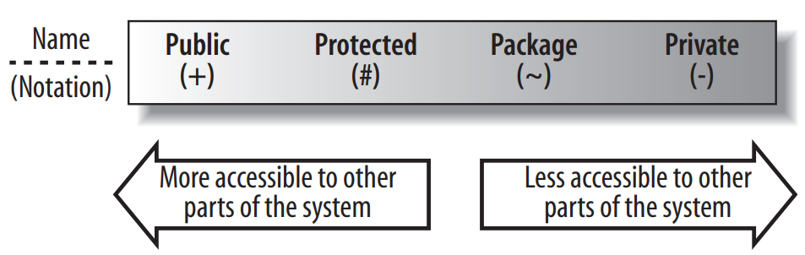
Super-type’s attribute and method visibility
A sub-type has privileged access to the protected attributes and methods of its super-type
Attributes and methods marked as private are not visible in the super-type to the sub-type(s)

Slide 7
Polymorphism
many-forms (or many shapes)
Polymorphic behaviour is where a method can be invoked on a reference to Super-Type (e.g. Animal) but the method actually used is implemented in the concrete Sub-Type (e.g. Cow)
In this example, a.talk() is dynamically bound at run-time.
import java.util.*;
public class AnimalTest {
public static void main(String[] args) {
ArrayList<Animal> zoo = new ArrayList<>();
zoo.add(new Cat("felix"));
zoo.add(new Dog("max"));
zoo.add(new Cow("daisy"));
for (Animal a: zoo) {
a.talk();
}
}
}

Slide 8
Overview
Inheritance & Polymorphism Demo

Slide 9
Demo
In an epic battle between Human and Machine…or was that Human and Human…or was that Machine and Machine
The stakes are high...
Who will win…?
Who will have the rights to rule…?
Yes, who will guess the correct number in a guessing game.

Slide 10
Problem
Yes, the scenario is thus:
Two or more players, which can include human and computer players will take turns to guess a number.
The first player to guess the correct, randomly generated number will win

Slide 11
UML
Player
# maxValue : int - name: String
+ Player(name: String, maxValue: int) + guess() : int + getName() : String
HumanPlayer
+ HumanPlayer(maxValue: int) + guess() : int
ComputerPlayer
+ ComputerPlayer(maxValue: int) + guess() : int
Guess will be entered via the keyboard
Guess will generated randomly

Slide 12
Let’s see the implementation

Slide 13
Computer Player with Memory
Let’s extend ComputerPlayer to create a new one that has a memory of up to its last 5 guesses
We’ll call it CleverComputerPlayer (really?!)
It overrides the ComputerPlayer’s guess() method – but also reuse it

Slide 14
UML
Player
# maxValue : int - name: String
+ Player(name: String, maxValue: int) + guess() : int + getName() : String
HumanPlayer
+ HumanPlayer(maxValue: int) + guess() : int
ComputerPlayer
+ ComputerPlayer(maxValue: int) + guess() : int
CleverComputerPlayer
- guesses: int[5] - guessAttempts: int = 0
+ CleverComputerPlayer(maxValue: int) + guess() : int - alreadyGuessed(guess: int) : boolean

Slide 15
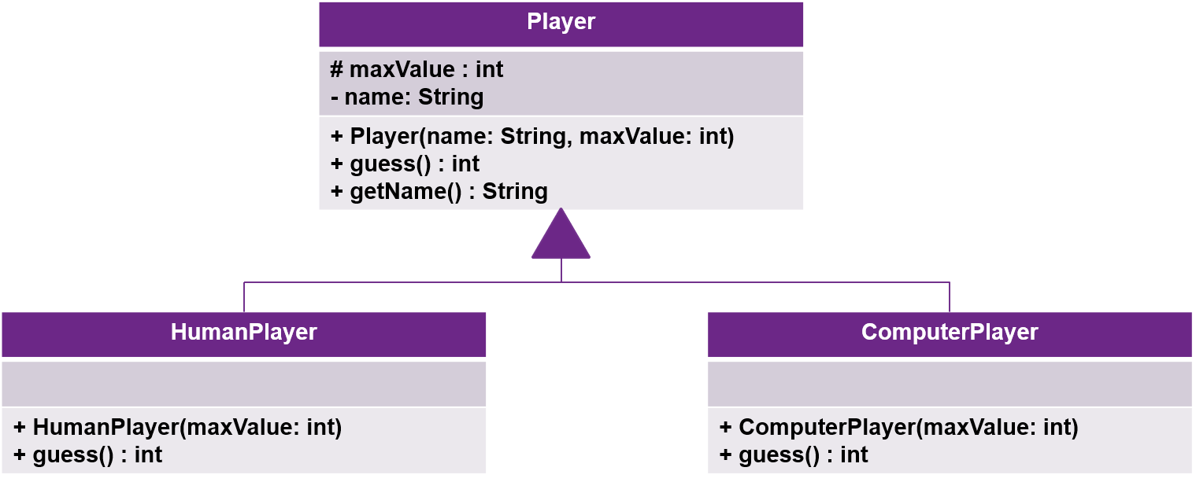
UML
guesses – an array will keep track of up to 5 previous guesses
guessAttempts – an integer counter keeping track of the total number of guesses made so far.
CleverComputerPlayer
- guesses: int[5] - guessAttempts: int = 0
+ CleverComputerPlayer(maxValue: int) + guess() : int - alreadyGuessed(guess: int) : boolean

Slide 16
Clever Computer Player guesses state
INDEX
0
1
2
3
4
At Start
DATA
-1
-1
-1
-1
-1
INDEX
0
1
2
3
4
At 1 turn
DATA
5
-1
-1
-1
-1
INDEX
0
1
2
3
4
At 5 turns
DATA
5
7
4
1
0

Slide 17
Clever Computer Player state
INDEX
0
1
2
3
4
At 7 turns
DATA
9
8
4
1
0
The “algorithm” will start overwriting previously recorded guesses

Slide 18
Clever Computer Player algorithm
FUNCTION guess()
DO
generate random number between 0 and 10 -> guess-attempt
UNTIL NOT guessed-already(guess-attempt)
ADD guess-attempt TO previous-guesses
RETURN guess-attempt

Slide 19
Notes
When adding to the memory, we’ll wrap around the array
INDEX: 0, 1, 2, 3, 4, 0, 1, 2, 3, 4, 0, 1, 2, 3, 4 …
Effectively overwriting the “oldest” memory each once we’ve had more than 5 turns
guess-attempts modulo 5 will give us the index in the array to add the new guess
INDEX
0
1
2
3
4
DATA
-
-
-
-
-

Slide 20
Clever Computer Player
FUNCTION guessed-already(guess):
FOREACH previous-guesses -> pg
IF pg == -1: RETURN FALSE
ELSE pg == guess: RETURN TRUE
RETURN FALSE

Slide 21
Let’s implement CleverComputerPlayer

Slide 22
Let’s Play!
Different permutations of Players
Human vs Computer Player
Human vs Clever Computer Player
Computer vs Computer
…
Increase the number of turns
Increase the maximum value to be guessed
…

Slide 23
Java Doc
Examples

Slide 24
JavaDoc examples
/** Represents an employee
* @author steven
* @version 1.0
* @since 1.5
*/
public class Employee {
// ...
}
/** Create an employee with the specified name, grade and staff id.
* @param firstName
* @param lastName
* @param grade
* @param staffId
*/
public Employee(
String firstName,
String lastName,
int grade,
String staffId) {
this.firstName = firstName;
// .. rest of ctor implementation ...
}
Class information.
Constructor.

Slide 25
JavaDoc examples
/** Allocates a project to this Employee object - a check is made to ensure
* that they're not already working on the project.
* @param project - The project to allocate to the employee.
* @see Project
*/
public void addProject(Project project) {
if(!isOnProject(project)) {
projects.put(project.getCode(), project);
}
}
Method that accepts argument(s) but returns nothing.
/** Returns the full name of the employee.
* @return String - The concatenated first and last name of the employee.
*/
public String getName() {
return firstName + " " + lastName;
}
Method that only returns a value, no arguments taken.

Slide 26
JavaDoc examples
/** Check if this employee is working n the specified project.
* @param project
* @return boolean - True if the employee's projects do include the
* project specified, False otherwise.
* @see Project
*/
public boolean isOnProject(Project project) {
return projects.containsKey(project.getCode());
}
Method that accepts arguments and returns a value.

